Slide 1
Three-Dimensional Tracking of Axonal Projections in the Brain by Magnetic Resonance Imaging ---S.Mori, B. Carin, V.P. Chacko
Presented by Zhou Li

Slide 2
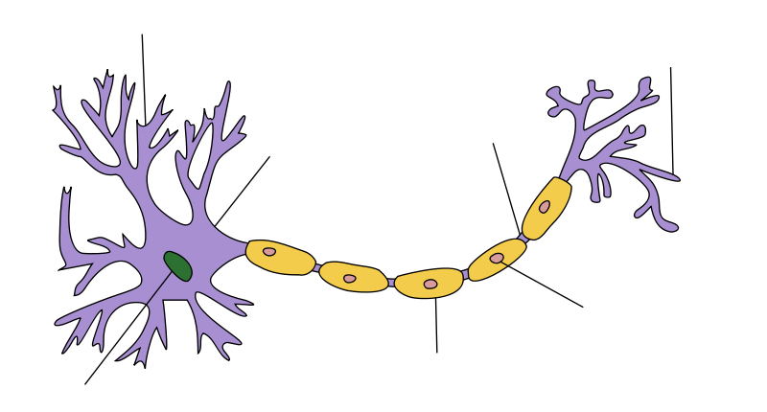
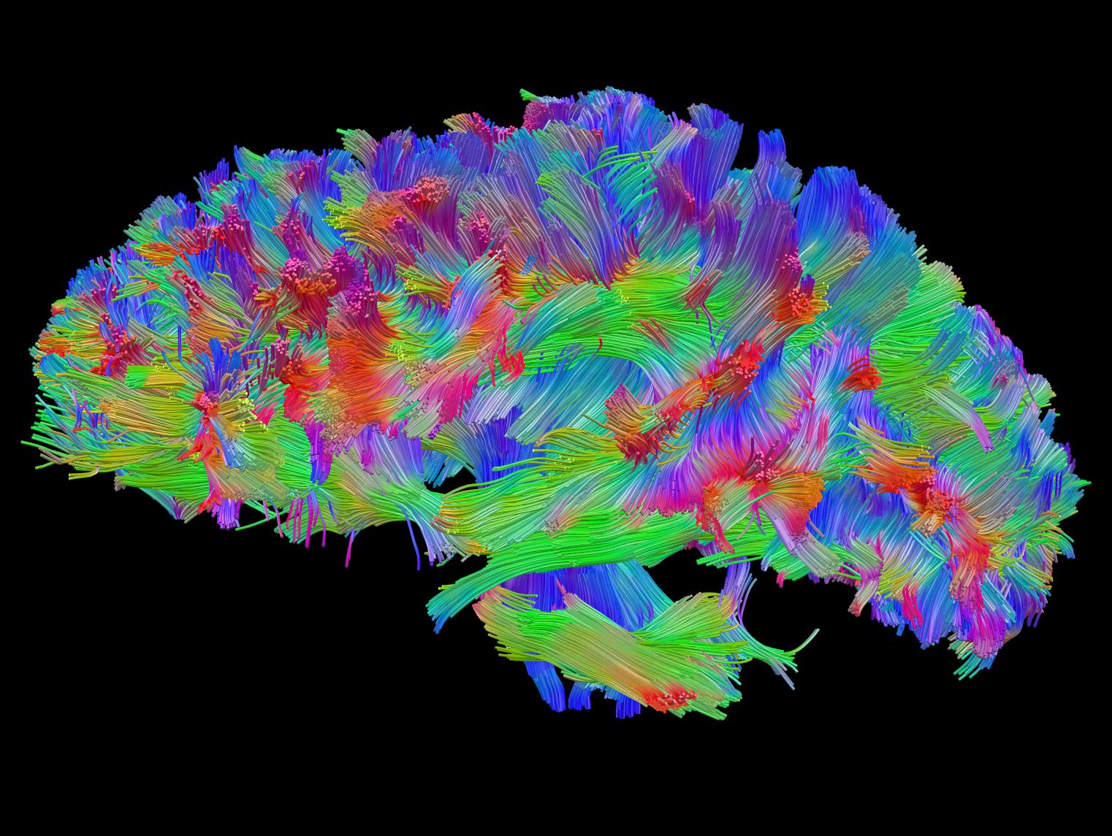
Summary
Explanation of FACT analysis (fiber assignment by continuous tracking) to achieve high-resolution three-dimensional tracking of axonal projections

Slide 3
Opportunity
“The neuronal projections have been traced in experimental animals, using invasive in vivo experiments, but comparable human date are much more limited…”
“The availability of a noninvasive method for fiber tracking would have a tremendous impact on our understanding of normal and abnormal brain function.”

Slide 4
Background: MRI
Spin creates magnetic moment
First magnetic field
Spins aligned parallel or anti-parallel with the external magnetic field.
RF Pulse
Excess energy detected by a coil in the MRI scanner – an estimate of number of hydrogen nucleuses
Notes:
The fundamental property that enables MRI is spin. Spin is a more abstract property than for example electrical charge or mass, but is just as fundamental.
All elementary particles, protons, electrons and neutrons, possess a spin
To easier understand spin one can think of it as if the particle rotates around its own axis.
If the particle has an unpaired nuclear spin it causes the particle to behave like a tiny magnet with a north and south pole,
Then a switch-on-and-off RF pulse that is slanted away from the first magnetic field is applied to the body. After RF pulse is removed, the particles begin to return to the natural alignment

Slide 5
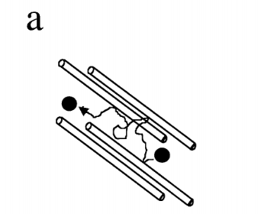
Diffusion-weighted MRI
Measures the motion of water molecules, known as diffusion.
Water in tissues diffuses fastest along the direction that the fibers are pointing in and slowest at right angels to it.
Notes:
The principle of water-diffusion anisotropy is shown in Fig- ure 1a. For a region where axons are aligned, water is re- stricted in the direction perpendicular to the axons and dif- fuses preferentially in a direction parallel to them.

Slide 6
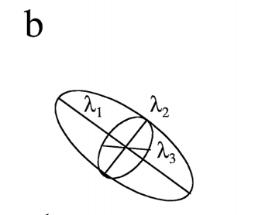
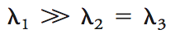
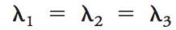
Anisotropic diffusion: When the diffusion is concentrated to a preferred direction
Isotropic diffusion: When water diffuses in a spherical pattern that contain few fibers since the restriction is identical in very direction
Notes:
This situation can be represented mathematically by a so-called diffusion ellipsoid
characterized by diffusion constants 1, 􏰏2, and 􏰏3 along its three orthogonal directions

Slide 7
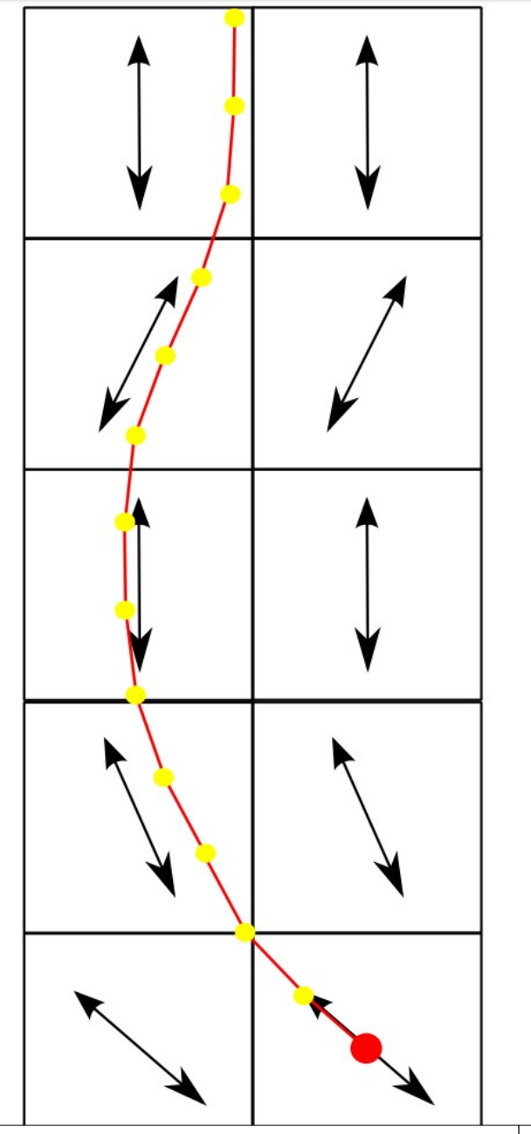
Fiber tracking
-Connect each voxel to the adjacent one toward which the fiber is pointing
-Limited to 8 angles in 2D and 26 angles in 3D

Slide 8
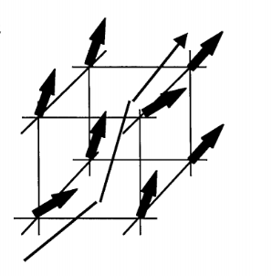
MRI Data
Calculate the average axonal orientation within a voxel
Resolution-dependent: MRI can only give info on the average axonal orientation within a voxel.

Slide 9
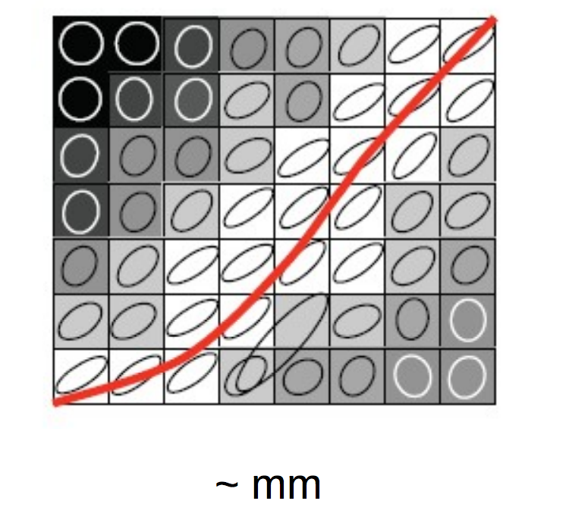
limitation
A macroscopic representation of the white matter; not actually a measure of a single axon
Unable to track multiple fibers
Unable to track crossing fibers
Notes:
In practice, voxels are more likely to consist of contributions from multiple tissues (different white matter tracts, some CSF and gray matter, etc.) and signal-to-noise may be limited. In addition, there may not be a single predominant direction of water diffusion.
First of all, this technique can be used only for macroscopic analysis of white matter architecture, but not to address connectivity questions at the cellular level. One particularly limiting problem related to this macroscopic character of DTI is the mixing of axonal tracts with different orientations within a pixel. DTI may be able to locate where these problematic pixels are, but it is difficult to decipher axonal information in such pixels. On the other hand, there are some approaches that circumvent this issue under favorable conditions, such as the use of reference ROI placement based on prior knowledge. The most important conclusion that can be drawn in this initial phase of the field is that DTI tractography can indeed delineate the core of large white matter tracts as judged from the encouraging results from initial validation studies. At present, there are no other non-invasive techniques that can provide equivalent information and, as a consequence, DTI tractography is expected to be a powerful technique to investigate white matter anatomy and disease in situ in humans.

Slide 10
Questions?

